Slide 1
Special Data Types: Spatial Data
Day 13
Jeremy Mitchell & Ying Yap
Data Mettle
jeremy@datamettle.com, ying@datamettle.com

Slide 2

Schedule
AWST | AEST | Agenda | Facilitator
07:30 | 09:30 | Q&A, Issues & Announcements
07:45 | 09:45 | Introduction to spatial data | Ying
09:00 | 11:00 | Morning Tea
09:15 | 11:15 | Project Share (RTA) | Georgia Hamilton
10:00 | 12:00 | Using spatial data | Ying
11:00 | 13:00 | Lunch
11:45 | 13:45 | How to pitch a data science project | Jeremy
13:15 | 15:15 | Afternoon Tea
13:30 | 15:30 | Project pitch development | All
14:45 | 16:45 | Menti feedback & Closeout | Tamryn

Slide 3

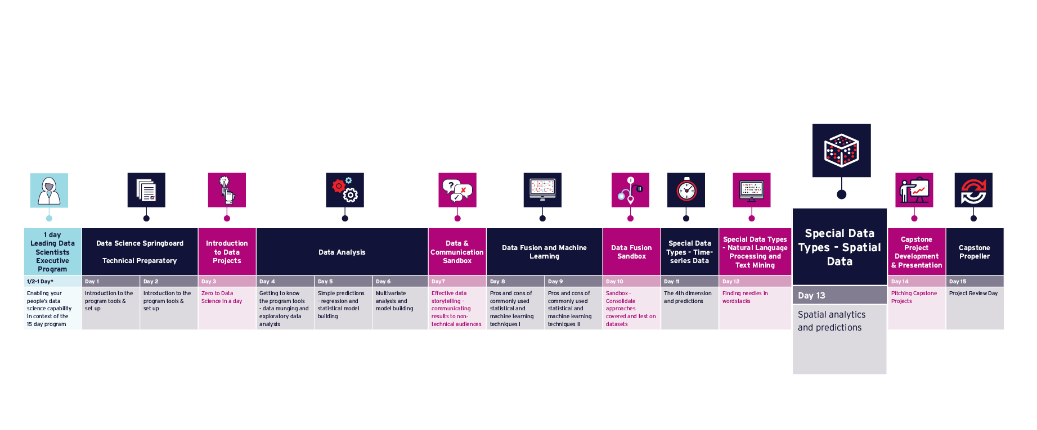
Program Timeline

Slide 4
Q&A, Issues & Announcements
Before we Get Started
Resources & Tasks
Reflections, questions and Issues: Teams
The afternoon is time to work on your project pitch and any questions you might have
Cericia Martinez & Guillaume Rongier | CSIRO

Slide 5

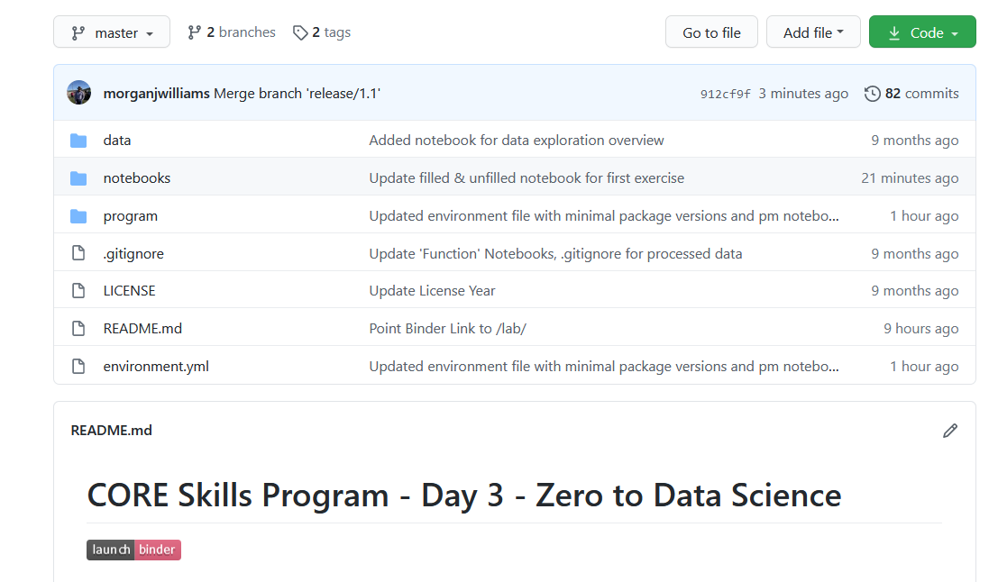

GitHub Content for Today using Binder
github.com / core-skills / 13-spatial-data
Cericia Martinez & Guillaume Rongier | CSIRO

Slide 6

GitHub – Program Notes
github.com / core-skills / 13-spatial-data / program / 00_overview.md
Cericia Martinez & Guillaume Rongier | CSIRO

Slide 7
Binder Backup
Cericia Martinez & Guillaume Rongier | CSIRO

Slide 8
Day 13
Extract geospatial features for data science applications.
Present the practical strategies for using geospatial data.
Understand vector and raster geospatial formats with feature extraction.
Understand projections and geocoding.
Understand how to manipulate spatial data sets.

Slide 9
Introduction to spatial data

Slide 10
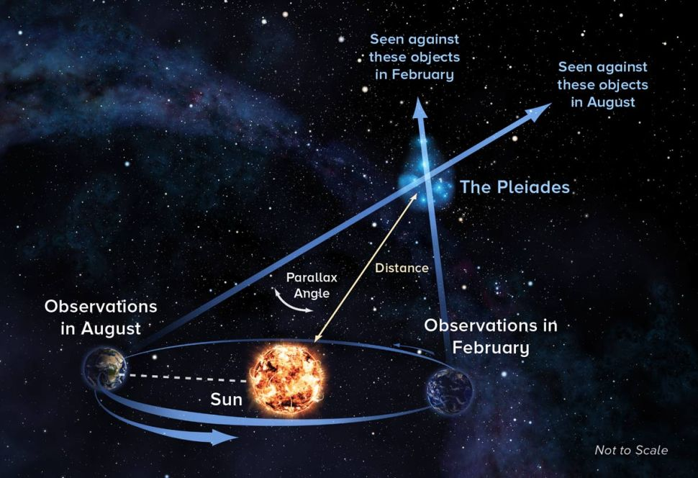
Fundamental concepts for spatial analysis
Key concepts
Space
Location
Distance
Each can be described as:
Absolute
Relative
Cognitive
Nominal
Cericia Martinez & Guillaume Rongier | CSIRO
From: https://www.space.com/30417-parallax.html

Slide 11
Fundamental concepts for spatial analysis
Space
Absolute space
mathematical space, things are given an (x, y, z) tuple and positions are unambiguous.
Relative space
Topological space, can be thought of as relative space. Used to represent connectivity between features of the world
Cognitive space
reflects people’s beliefs, experiences and perceptions about places.
Cericia Martinez & Guillaume Rongier | CSIRO

Slide 12
Fundamental concepts for spatial analysis
Location
Absolute
an unambiguous descriptor of location, expressed as a coordinate. Can’t be confused with any other location.
Example: Latitude and longitude.
Relative
Site (physical attributes of location) and situation (location relative to other places).
Example: Perth is located far from other cities, near raw materials etc. Or 191 St Georges Terrace
Cognitive
Compiled from personal knowledge, experiences, and impressions
Example: traditional knowledge of waterholes as a resource, then a stock route, then a 4WD track. Same physical location but different perception.
Nominal
Where were you when…? Linking space and time.
Example: Where were you when you heard about 9/11?
Cericia Martinez & Guillaume Rongier | CSIRO

Slide 13
Fundamental concepts for spatial analysis
Distance
Absolute
a physical unit of measure Example: kilometers between two assets
Relative
Generally calculated using time, effort or cost (will differ from absolute – what happens when you go over a mountain range?). Example: voting maps sized by number of seats vs area.
Cognitive
Individual perception of distance. Example: driving in NZ vs driving in Australia
Cericia Martinez & Guillaume Rongier | CSIRO

Slide 14
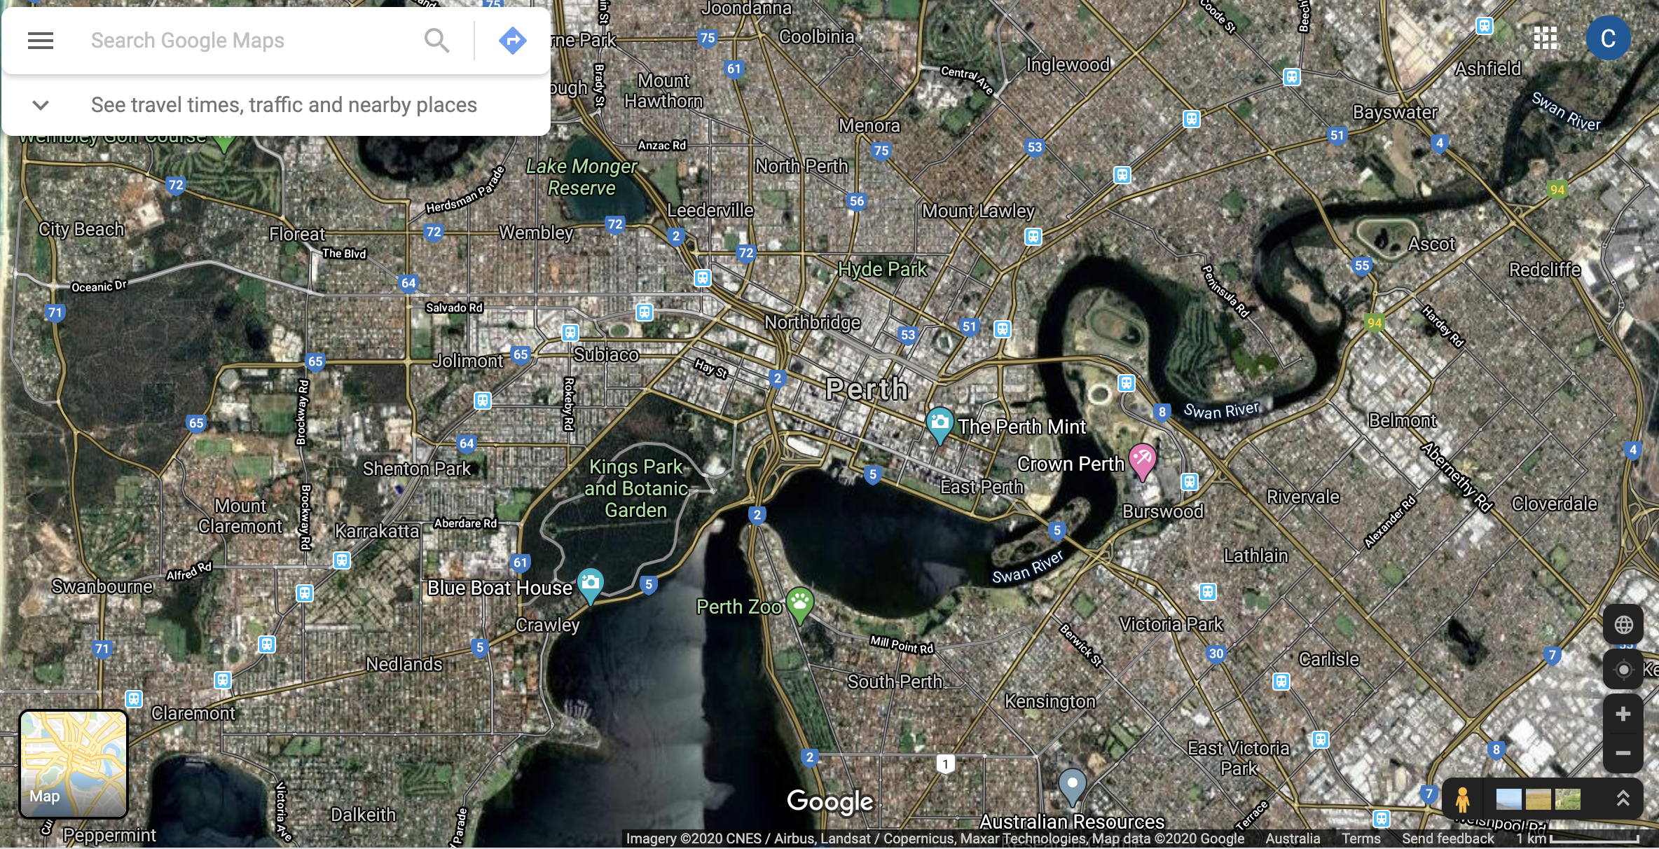
Geospatial data types
Objects and attributes
Raster
Vector
Point clouds
Cericia Martinez & Guillaume Rongier | CSIRO

Slide 15
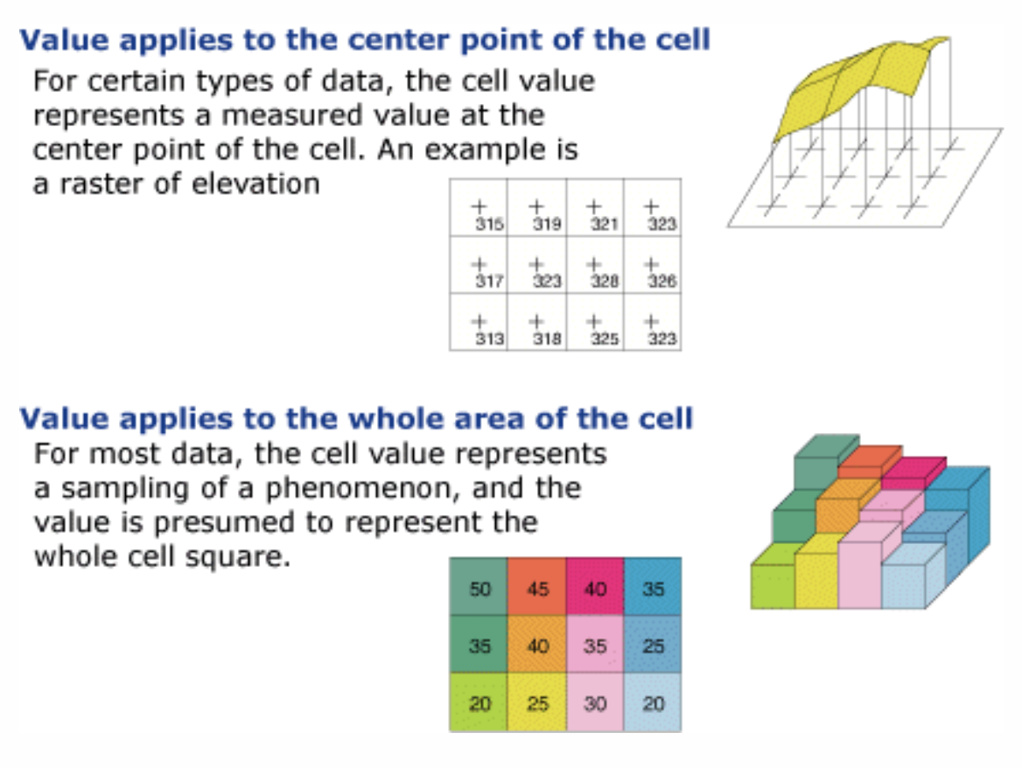
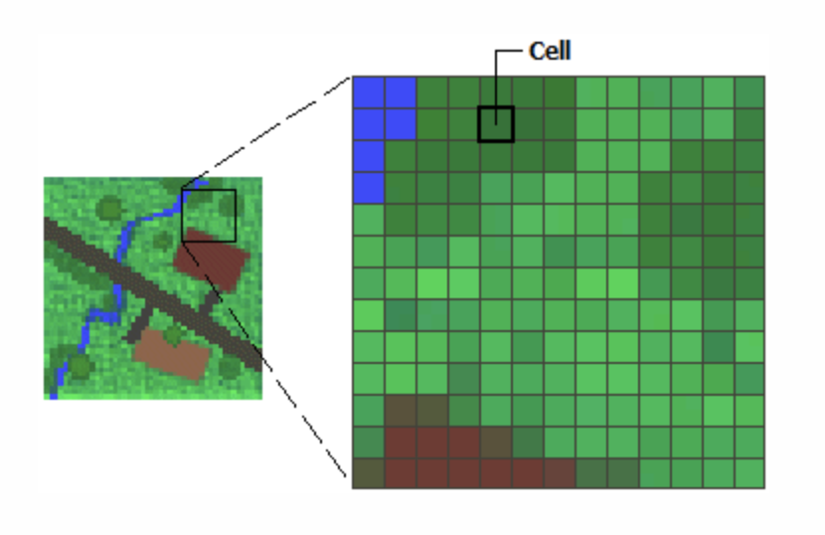
Geospatial data types
Raster
Regularly defined geographic space, often used for representing continuous phenomena. Example: orthophotos, remote sensing
Example Attribute: elevation, temperature
Cericia Martinez & Guillaume Rongier | CSIRO
From: https://desktop.arcgis.com/en/arcmap/10.3/manage-data/raster-and-images/what-is-raster-data.htm

Slide 16
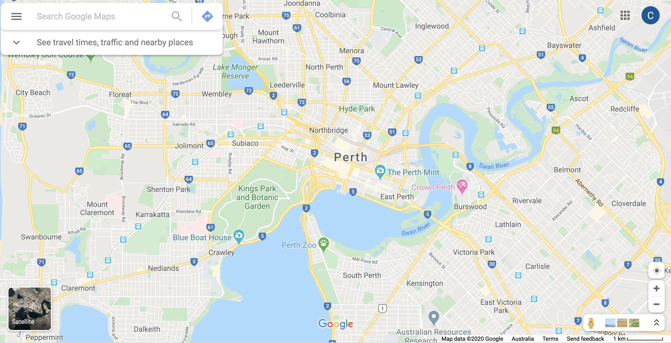
Geospatial data types
Vector
Defined as point, line, or polygon. Often used for representing discrete phenomena. Example: River locations
Example attribute: Name of river, pH measurement, date of pH measurement
Cericia Martinez & Guillaume Rongier | CSIRO

Slide 17
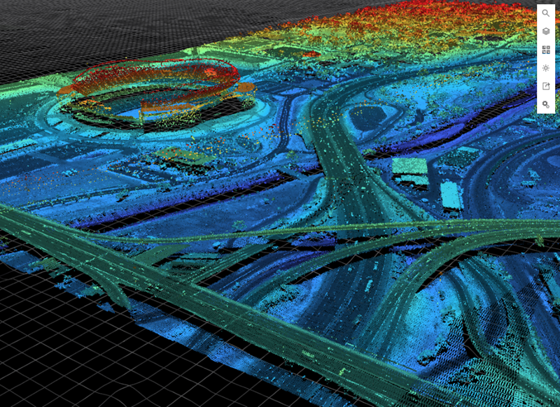
Geospatial data types
Point clouds
Vector space representation of a 3D surface or object. Example: lidar data
Example attribute: color
Cericia Martinez & Guillaume Rongier | CSIRO
From https://www.esri.com/arcgis-blog/wp-content/uploads/2017/12/blogoverview_smal_cr.png

Slide 18
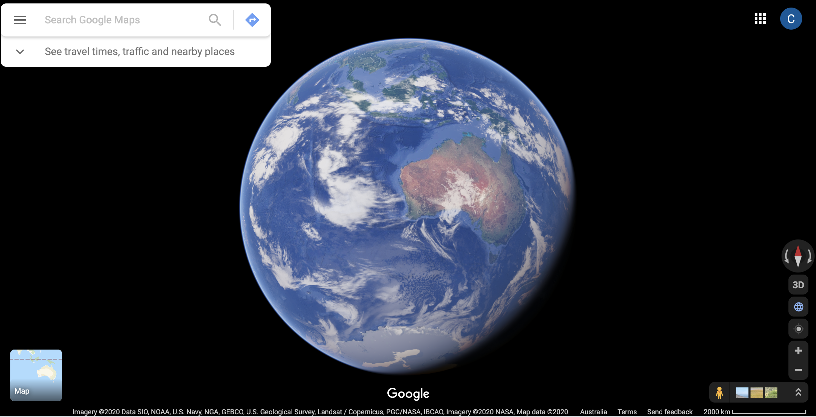
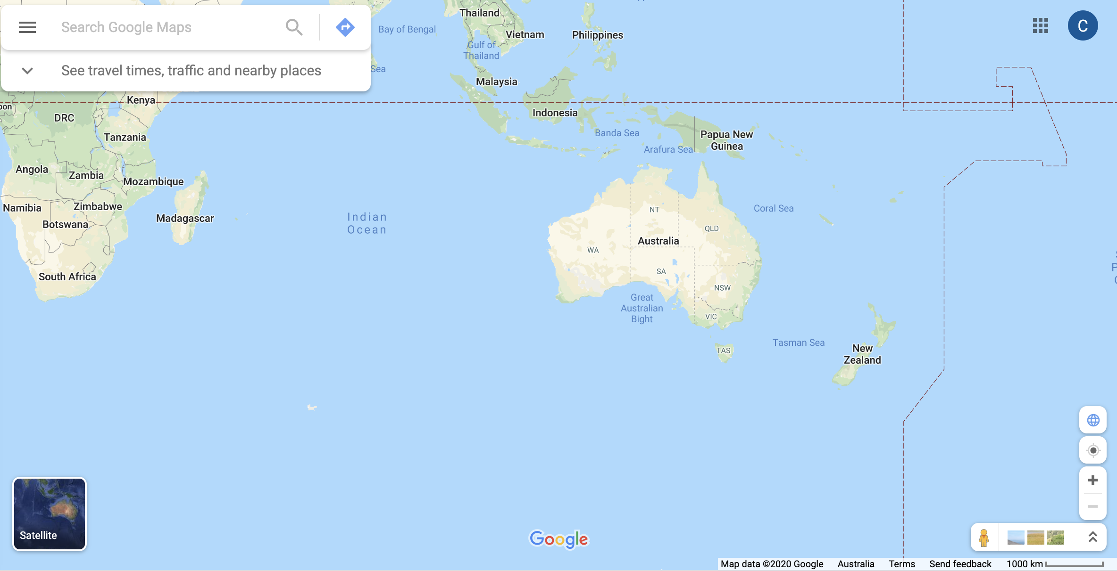
Spatial reference frame
A static reference surface for identifying locations on the earth.
Datum
Projection
Cericia Martinez & Guillaume Rongier | CSIRO

Slide 19
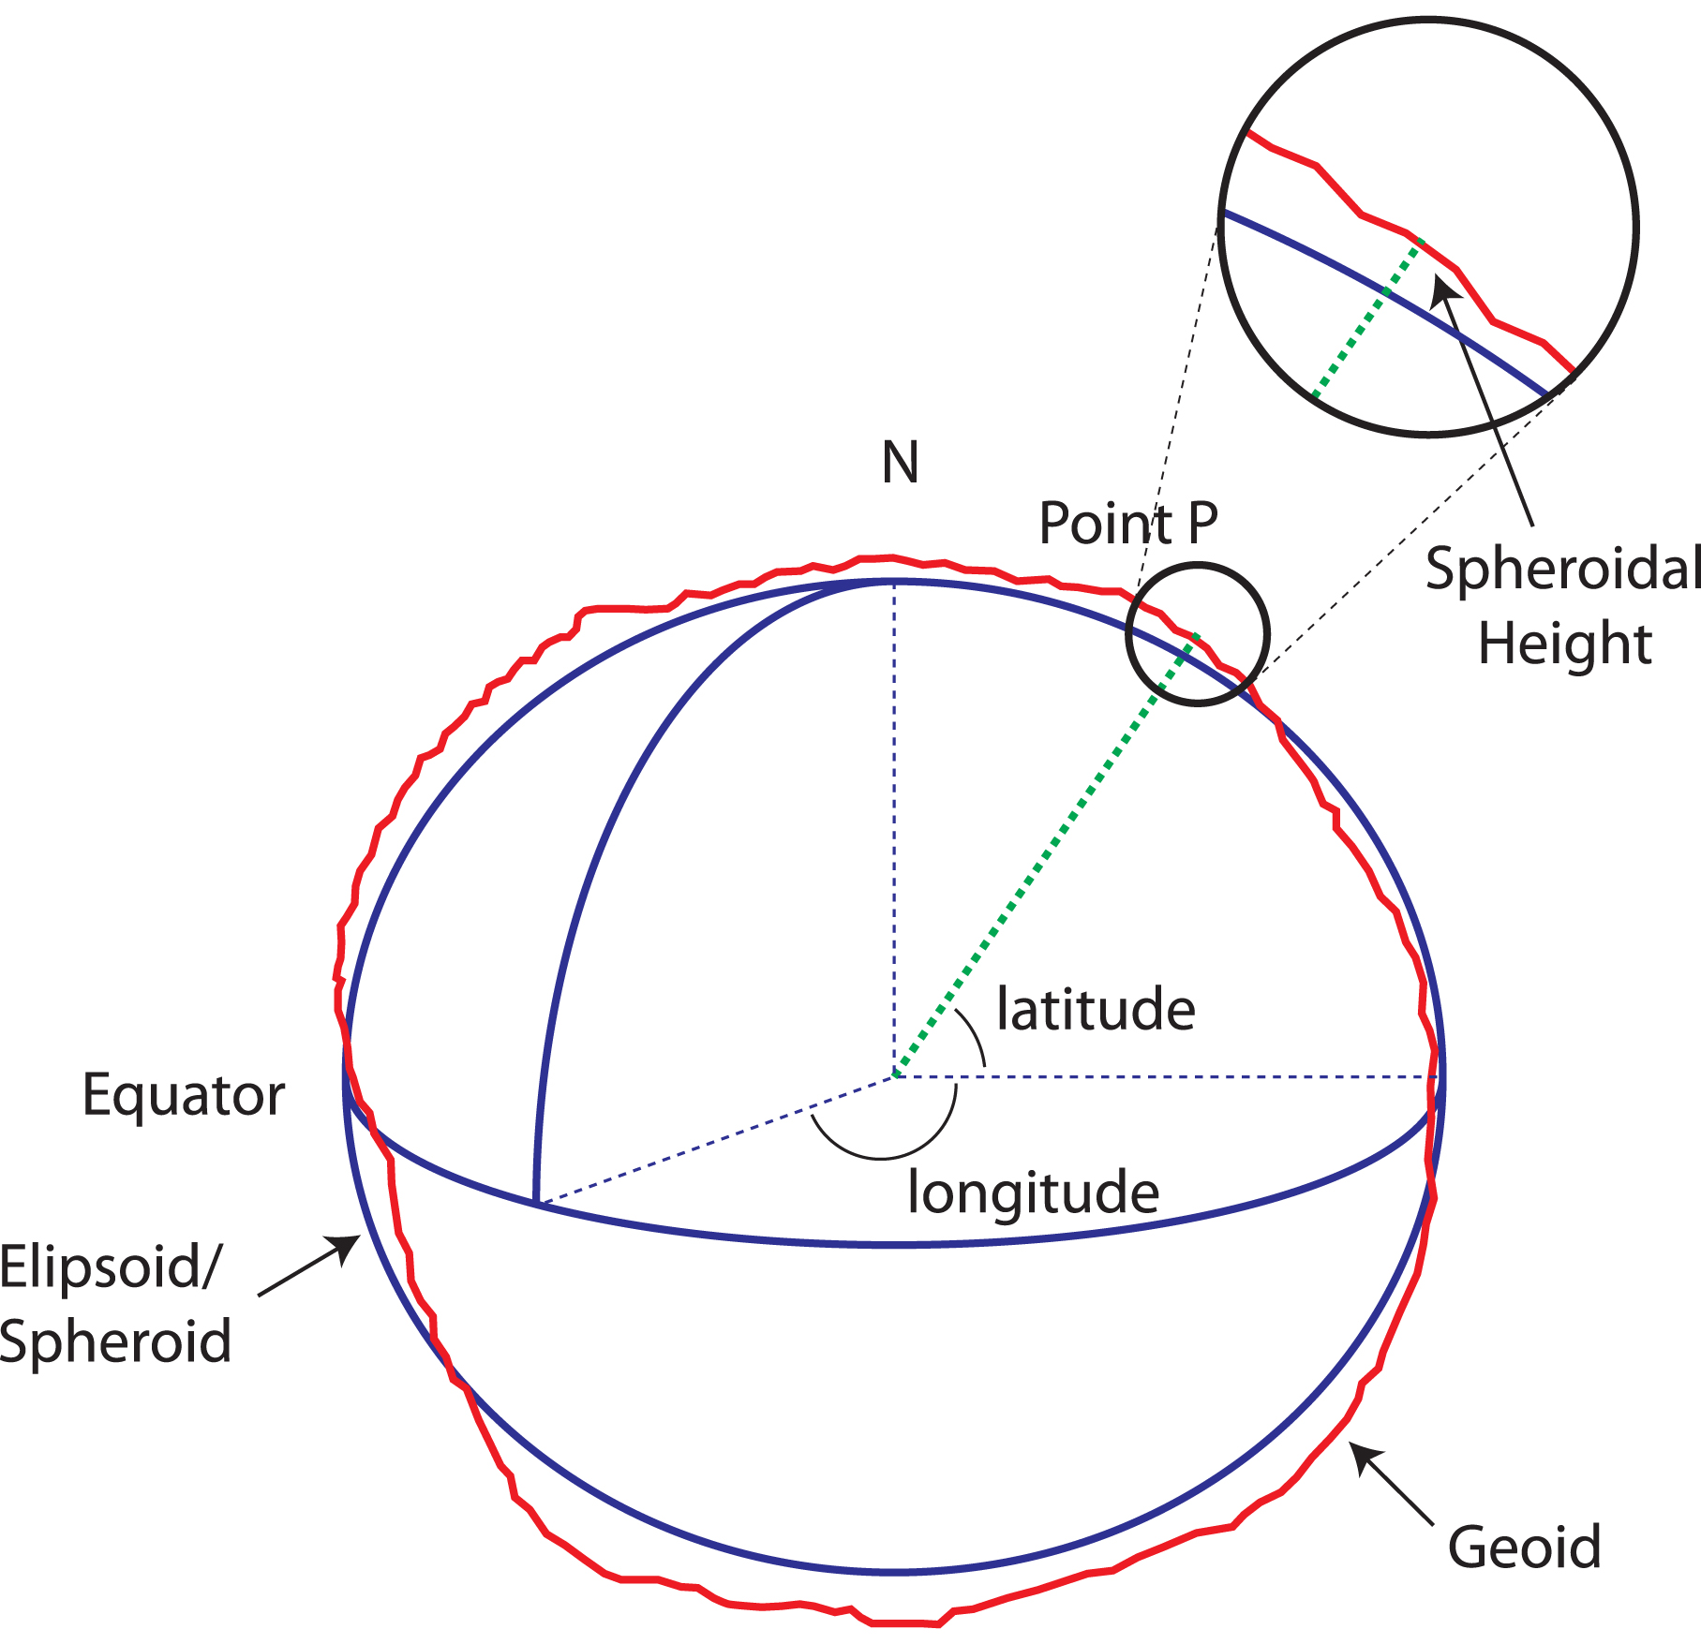
Spatial reference frame
Datum
A datum identifies how locations are specified on earth's surface.
A spheroid (or ellipsoid) is an approximation for the earth's surface, and acts as the reference for the datum.
From: https://www.icsm.gov.au/education/fundamentals-mapping/datums/datums-explained-more-detail
Cericia Martinez & Guillaume Rongier | CSIRO

Slide 20
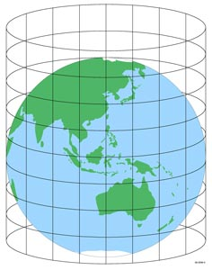
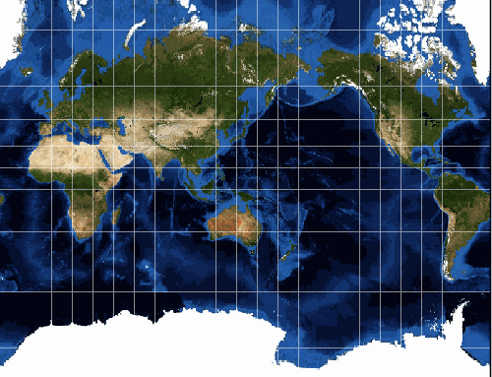
Spatial reference frame
Projection
A projection specifies how to represent the features from a spheroidal surface on a flat plane. Types of projection techniques include:
azimuthal
cylindrical
conical
Excellent reference:
https://www.icsm.gov.au/education/fundamentals-mapping/projections
From: https://www.icsm.gov.au/education/fundamentals-mapping/datums/datums-explained-more-detail
Cericia Martinez & Guillaume Rongier | CSIRO

Slide 21
Spatial reference frame
The actual location values (latitude, longitude) will vary depending on the reference frame.
It is important to make sure all spatial data have the appropriate spatial reference information in the metadata.
Cericia Martinez & Guillaume Rongier | CSIRO

Slide 22
Introduction to spatial data
Open am1_intro_to_spatial_data.ipynb
Cericia Martinez & Guillaume Rongier | CSIRO

Slide 23
Using spatial data

Slide 24
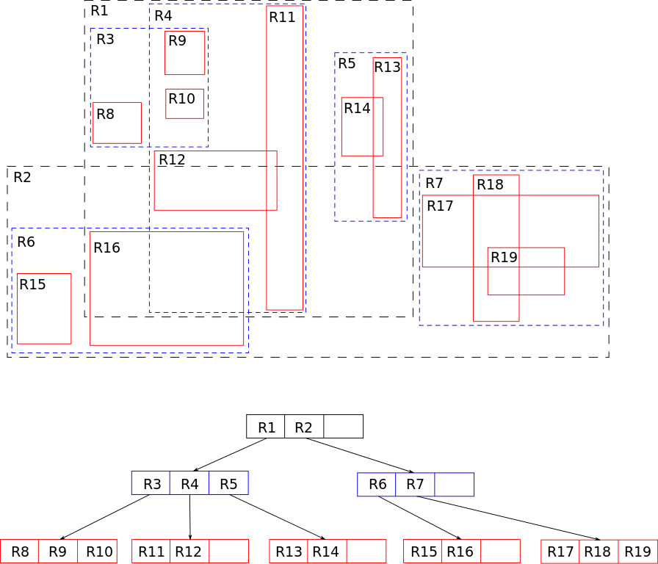
Standard spatial operations
Source: Wikipedia
Spatial index and selections
R-tree: hierarchical data structure in which nearby objects are grouped and represented by their minimal bounding rectangle
Used in spatial data bases for fast querying, e.g., nearest neighbours
Cericia Martinez & Guillaume Rongier | CSIRO

Slide 25
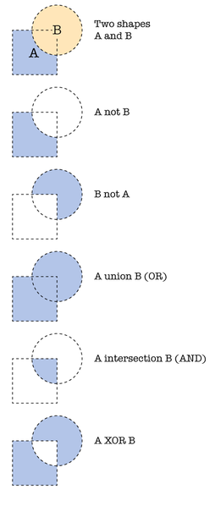
Standard spatial operations
Geometry operations
Splitting using overlay operations (intersect, union, join)
Joining/dissolving
Buffering/ eroding
Cericia Martinez & Guillaume Rongier | CSIRO
Source: Wikipedia

Slide 26
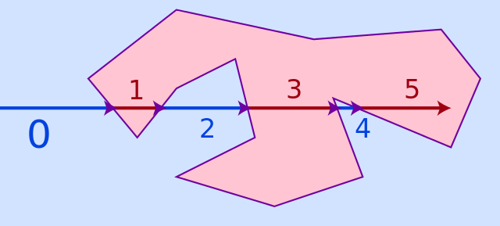
Standard spatial operations
Point in polygon
= Identifying whether a point lies inside or outside of a polygon
Several algorithms exist, the simplest being the Ray casting algorithm
Check how many times a ray starting from the point intersects a polygon’s edge:
Even = outside
Odd = inside
Source: Wikipedia
Cericia Martinez & Guillaume Rongier | CSIRO

Slide 27
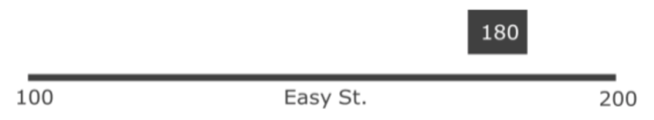
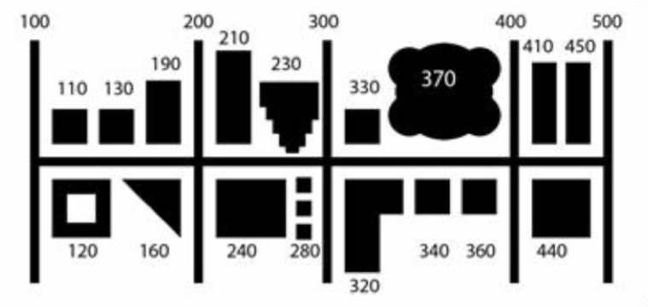
Standard spatial operations
Geocoding
= Turn a physical address (e.g., a street name) into geographical coordinates (e.g., latitude and longitude):
Linear geocoding (find a point along a line, e.g. 191 St Georges) – estimate from start and end points of the block. Not as accurate but easy to implement and data is commonly available
Area geocoding (find a point in a polygon) – much more accurate but requires lots more data
Cericia Martinez & Guillaume Rongier | CSIRO

Slide 28
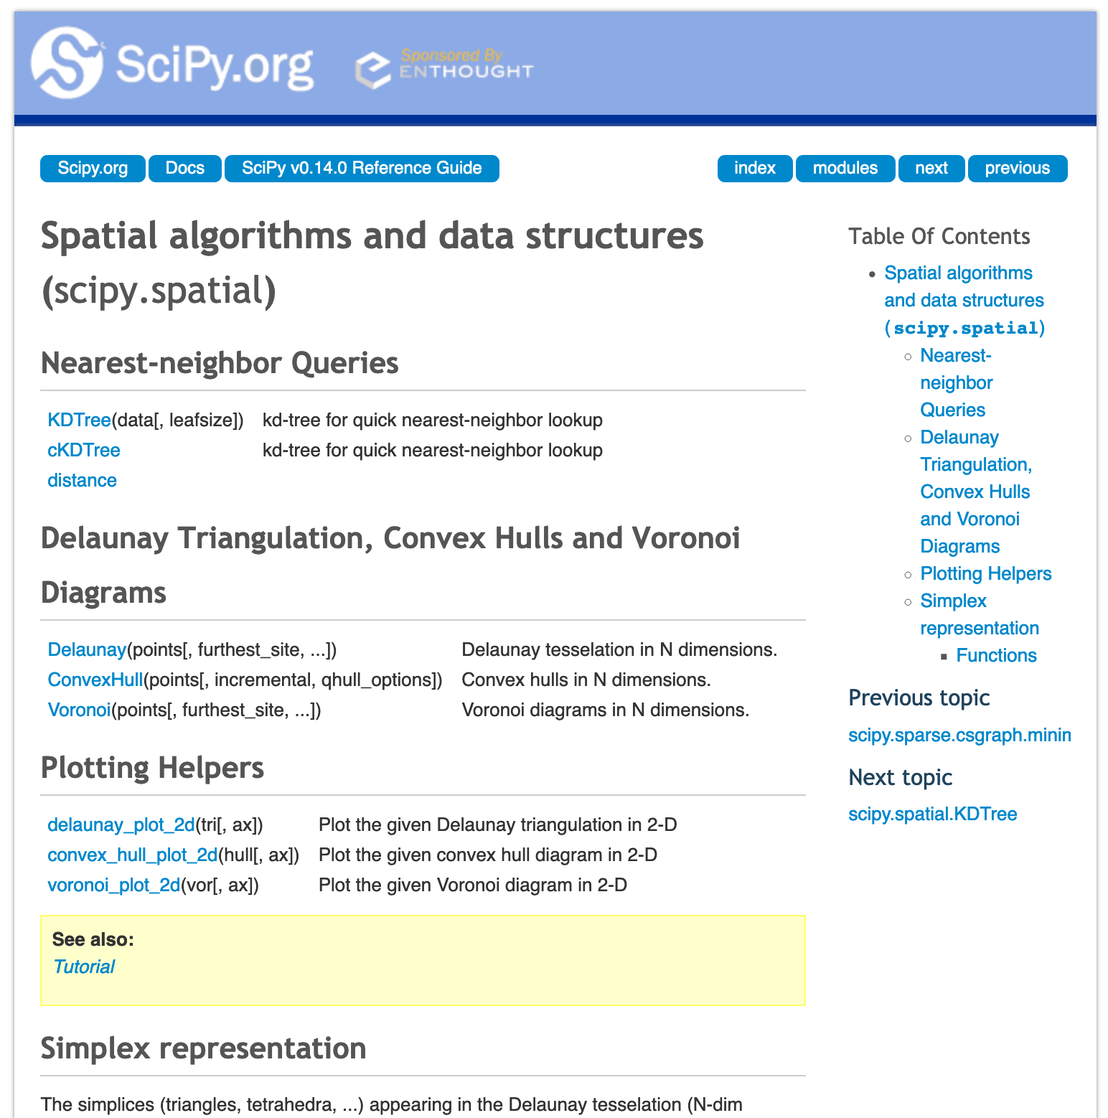
Standard spatial operations
Actual use
Generally, we don’t just want to do this ourselves – use an API!
See for instance scipy.spatial, shapely, or geopy in Python
Cericia Martinez & Guillaume Rongier | CSIRO

Slide 29
Standard spatial operations
Exercise
Open am2_geospatial_data_processing.ipynb and go through the notebook
Cericia Martinez & Guillaume Rongier | CSIRO

Slide 30
Spatial predictions
Why do we worry about space at all?
Tobler's first law of geography:
“Everything is related to everything else,
but near things are more related than distant things.”
To predict in space, each location is treated as a variable (same principle in time), and those variables are dependent.
Cericia Martinez & Guillaume Rongier | CSIRO

Slide 31
Spatial predictions
Covariance function
Mathematical formulation of the first law of geography
Defines how the correlation between two locations changes with distance
Variogram in geostatistics, kernel in machine learning
Source: Rasmussen and Williams (2006)
Cericia Martinez & Guillaume Rongier | CSIRO

Slide 32
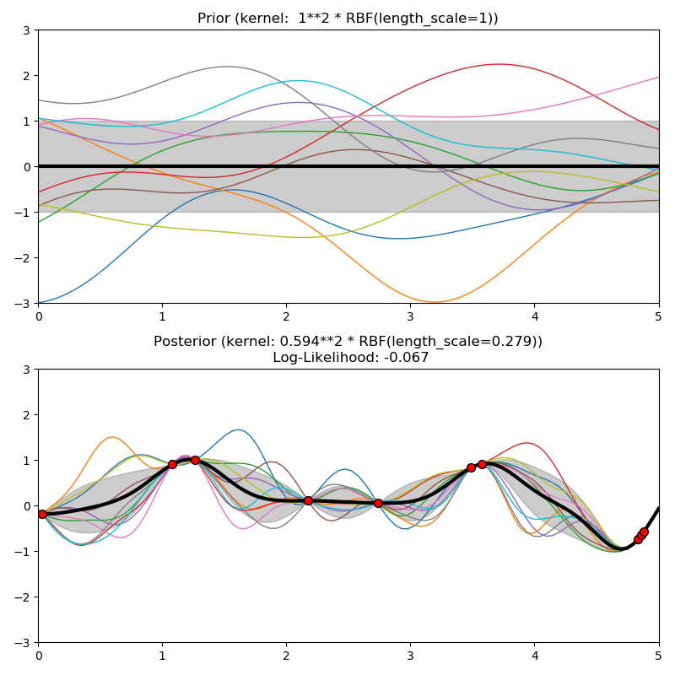
Spatial predictions
Gaussian processes
Supervised method for regression and classification that uses a covariance function to reproduce spatial continuity
Can fit data and provide prediction uncertainty
But computationally demanding
Equivalent to kriging in geostatistics
Source: Scikit-Learn documentation
Cericia Martinez & Guillaume Rongier | CSIRO

Slide 33
Spatial predictions
Gaussian processes
Supervised method for regression and classification that uses a covariance function to reproduce spatial continuity
Can fit data and provide prediction uncertainty
But computationally demanding
Equivalent to kriging in geostatistics
Source: Rgeostats documentation
Cericia Martinez & Guillaume Rongier | CSIRO

Slide 34
Takeaways

Slide 35
High-level Takeaways From Today
Today we've:
covered the basic concepts of spatial data: space, location and distance, and the different methods we use to talk about these concepts, including absolute, relative, topological and cognitive measures.
covered the basics of spatial data analysis, including geometry operations, spatial indices, and geocoding.
covered how spatial processing can form part of a larger machine learning or data science pipeline, particularly as a feature generator for machine learning algorithms.
covered how to design an effective pitch that considers the audience, communication styles and content structure.
Cericia Martinez & Guillaume Rongier | CSIRO

